Slide 1
3D printing of anatomical models Methods from the collaborative Erasmus+ project ACCEDE (Anatomically aCCuratE 3D modEls)
A collaborative work of MUNI, UNIBA, and LMU.

Slide 2
Motivation & Introduction

Slide 3
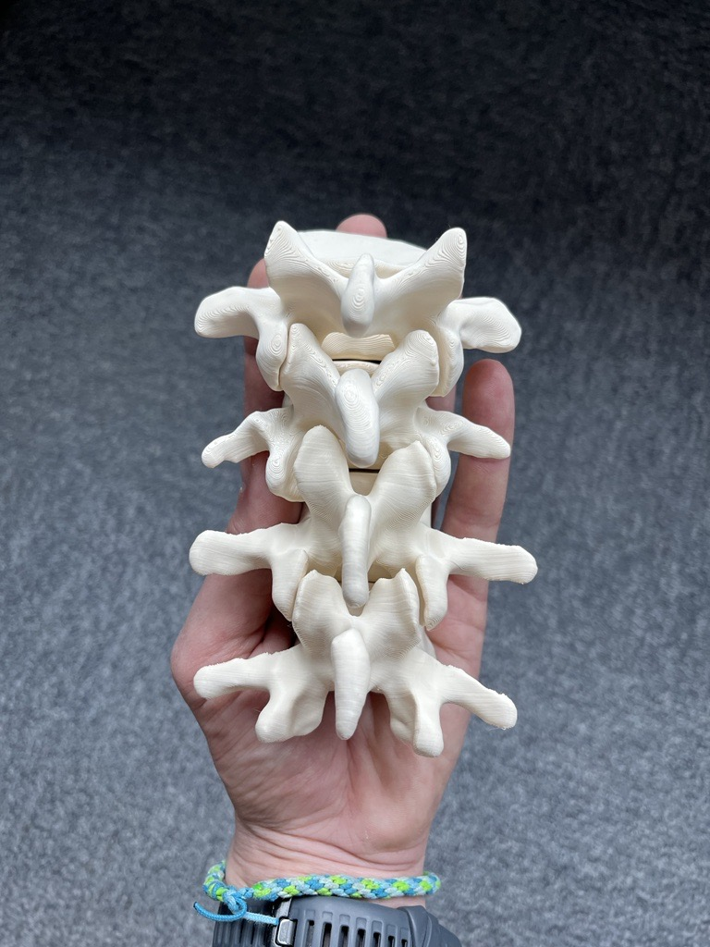
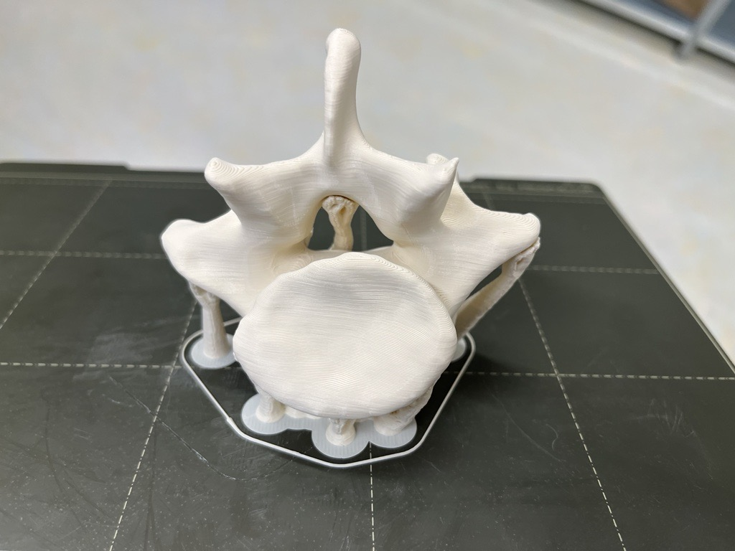
Vertebra and spine

Slide 4
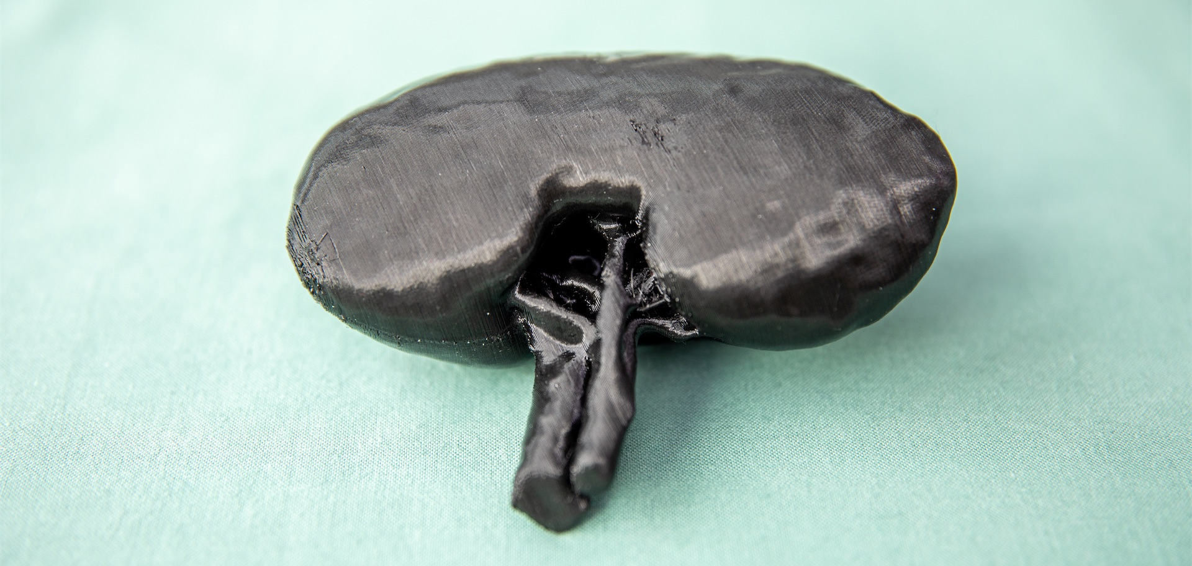
Kidney

Slide 5
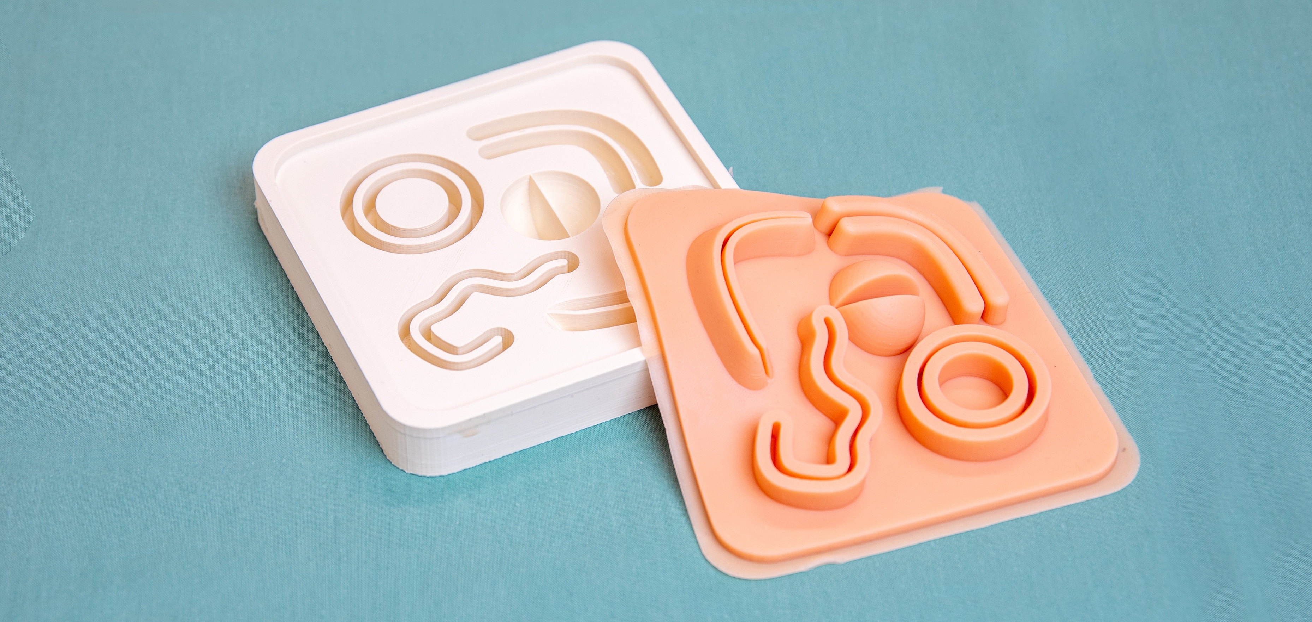
Laparo stitching skills trainer

Slide 6
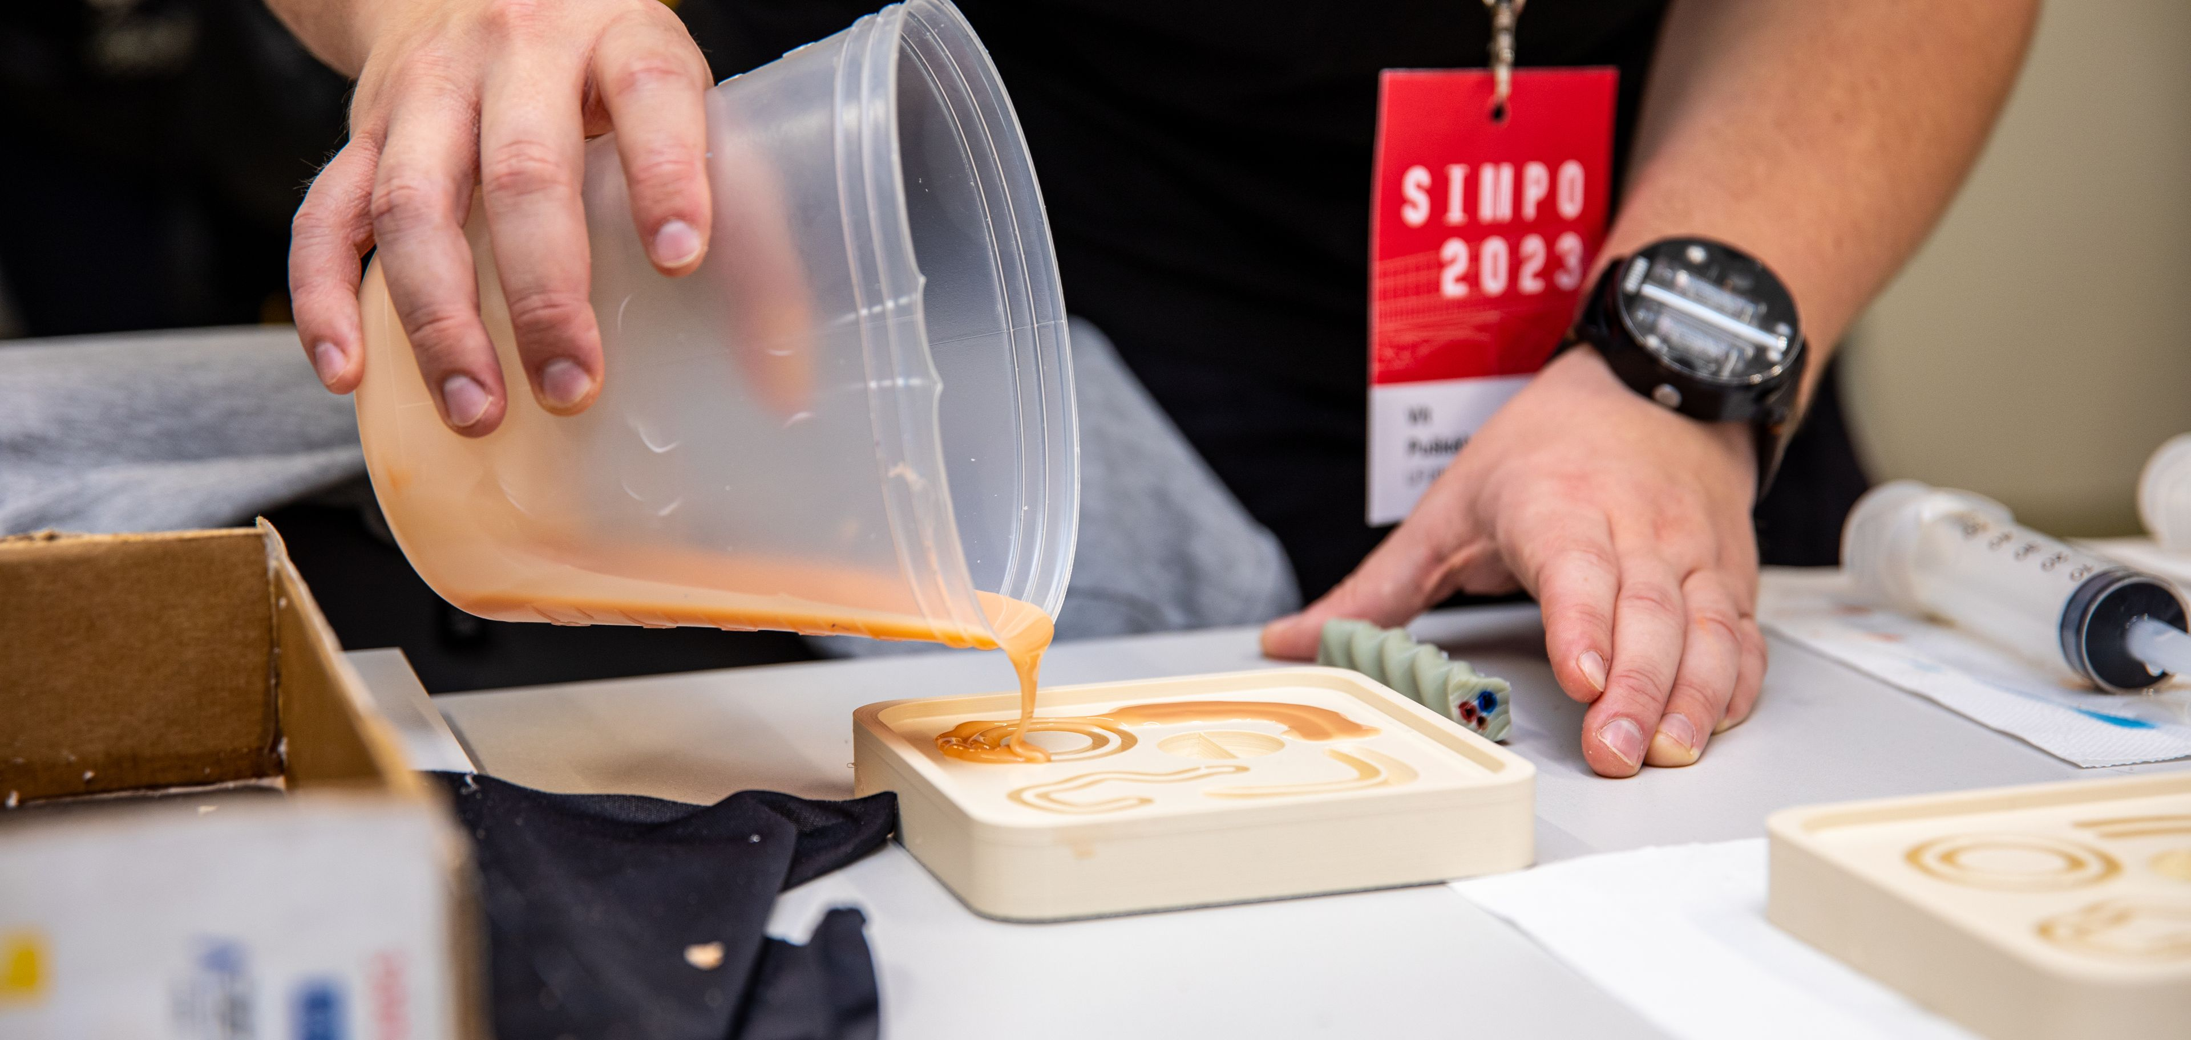

Slide 7
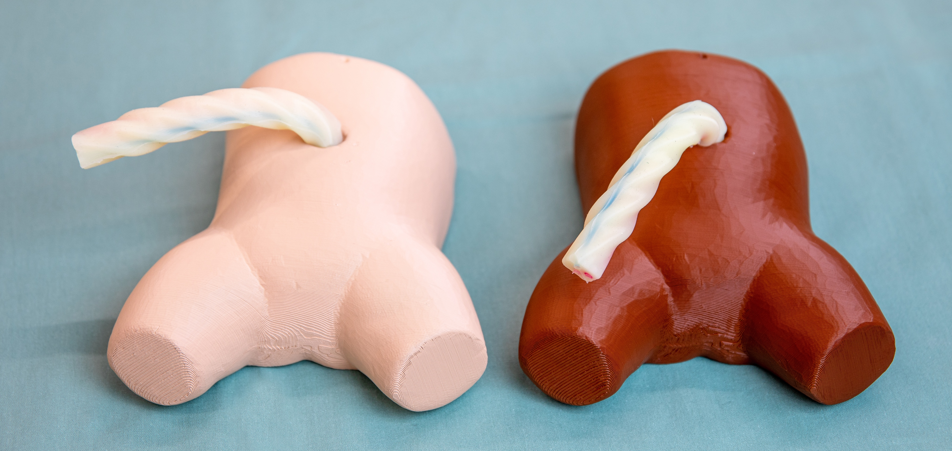
Umbilical cord catheterization

Slide 8
Anatomically aCCuratE 3D modEls
Create 3D models of
Anatomical structures (incl. pathologies)
Publicly available
Verified and validated
Erasmus+ KA2
Realization: 11/2022 – 11/2024

Slide 9
Anatomically aCCuratE 3D modEls
Partners
Masaryk University
Comenius University in Bratislava
Ludwig Maximilian University of Munich

Slide 10
The pipeline

Slide 11
The pipeline
Whole process of creating a model or a skills trainer
The evaluation and validation is the crucial step

Slide 12
The pipeline

Slide 13
The pipeline

Slide 14
The pipeline

Slide 15
The pipeline

Slide 16
The pipeline

Slide 17
The pipeline

Slide 18
The pipeline

Slide 19
The pipeline

Slide 20
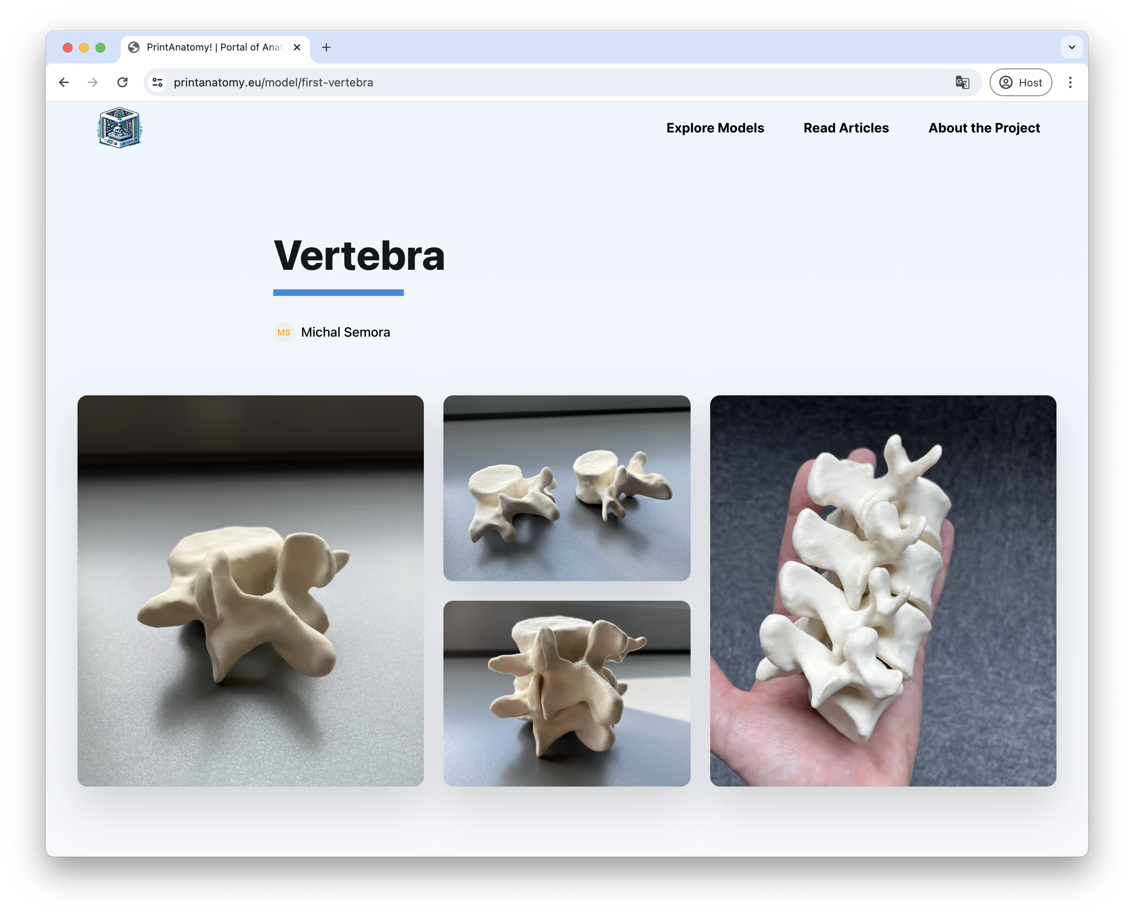
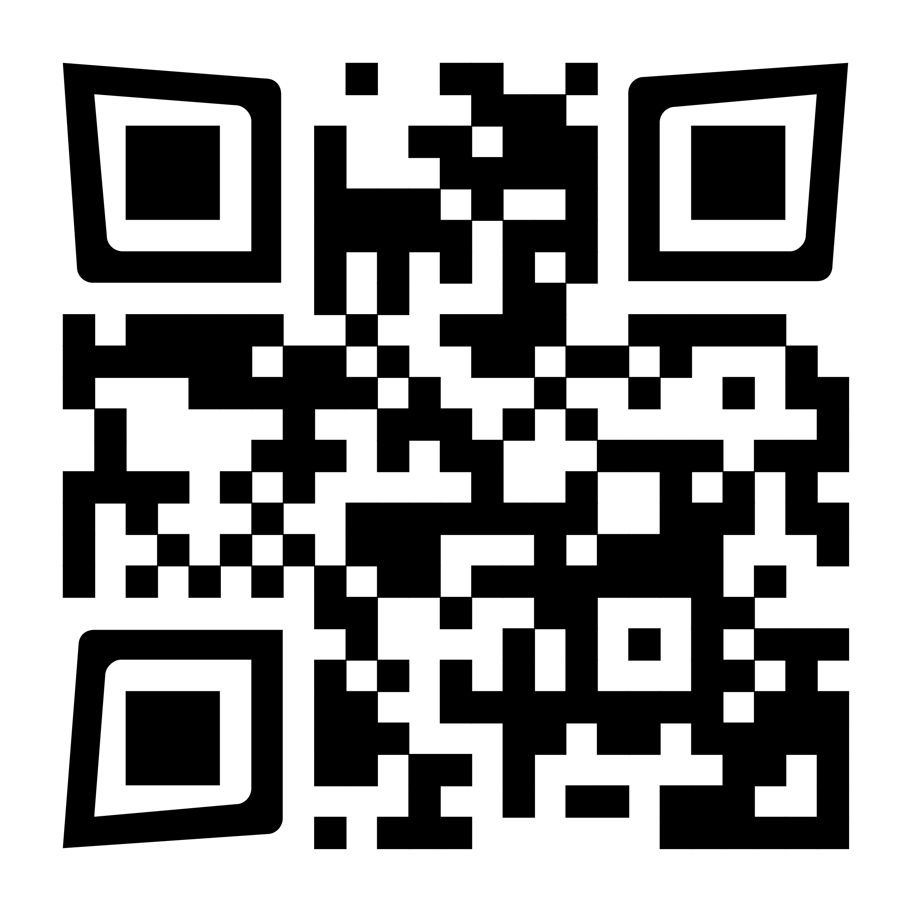
PrintAnatomy! https://printanatomy.eu

Slide 21
Let‘s try it!

